Slide 1
Structure and Union in C programming
Dr. Varsha Thakur
Assistant Professor
Govt. NPG College of Science Raipur

Slide 2
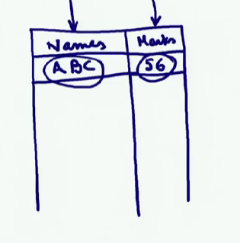
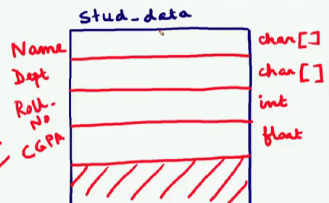
STRUCTURE
In the case of arrays we can store data only of a particular type, but we could not mix different types in the same array.
Student’s database where we will have the student’s name as well as the student’s marks
The question is what is the type of arrangement by which we can represent data of different types together?

Slide 3
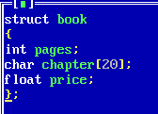
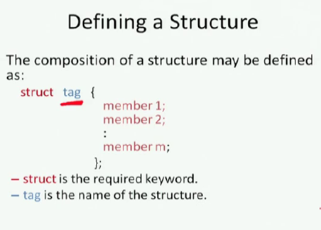
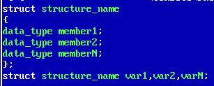
What is Structure?
A Structure is a convenient tool for handling collection of logical related data items, possibly of different types. Structure help to organize complex data in a more meaningful way. The individual elements of structure is called member of the structure.
Declaring Structure

Slide 4

ACCESSING STRUCTURE MEMBERS
STRUCTURE INITIALIZATION
There is a one-to-one correspondence between the members and their initializing values. C does not allow the initialization of individual structure members within the structure. We can initialize the first few members and leave the remaining blank. However, the uninitialized members should be only at the end of the list.
The uninitialized members are assigned default values as follows: –
Zero for integer and floating point numbers.
‘\0’ for characters and strings.

Slide 5
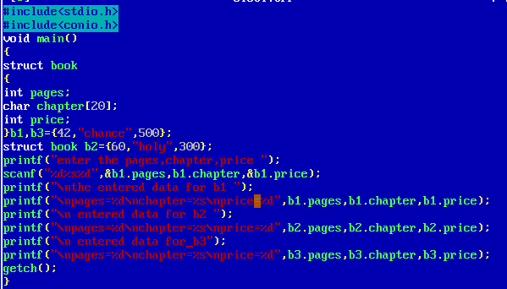

Slide 6
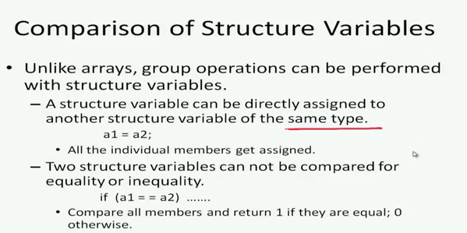
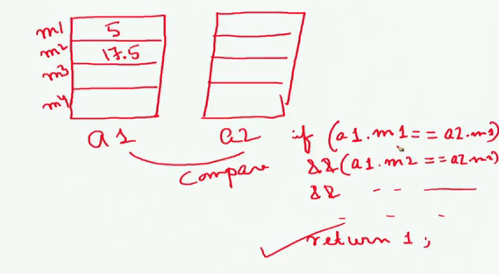
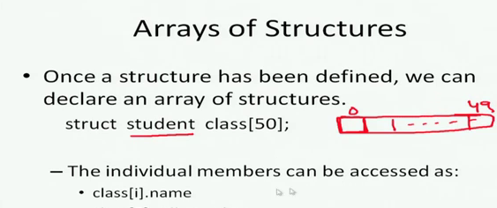
We could not compare arrays together. That array a 1 is equal to a 2 that was not possible, if we had to compare the array then element by element. On the other hand in the case of a structure, a structure variable can be directly assigned to another structure variable of the same type.

Slide 7
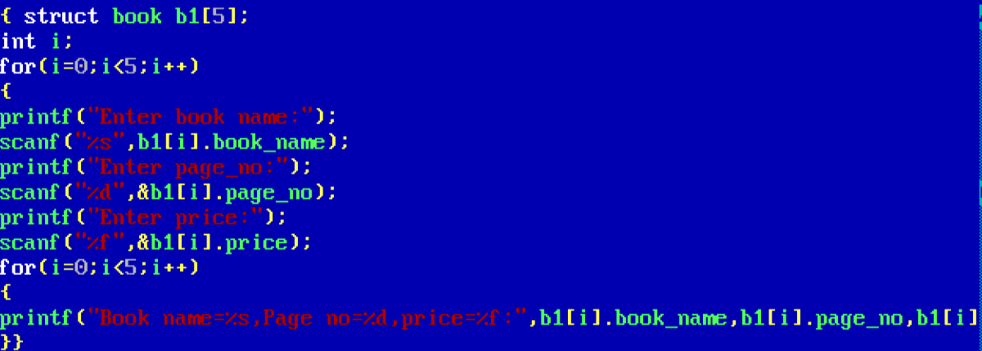

Slide 8
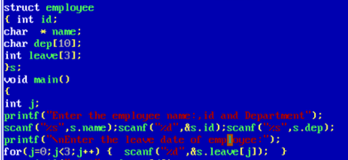
Array within Structures

Slide 9
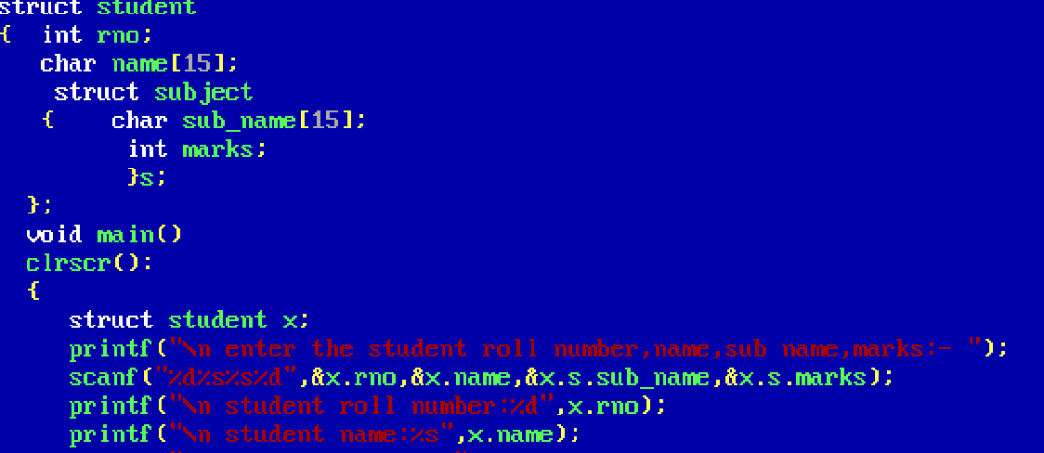
Structure Within Structure
One structure can be declared inside other structure as we declare structure member inside a structure. Structure within structure known as “Nested Structure” .

Slide 10
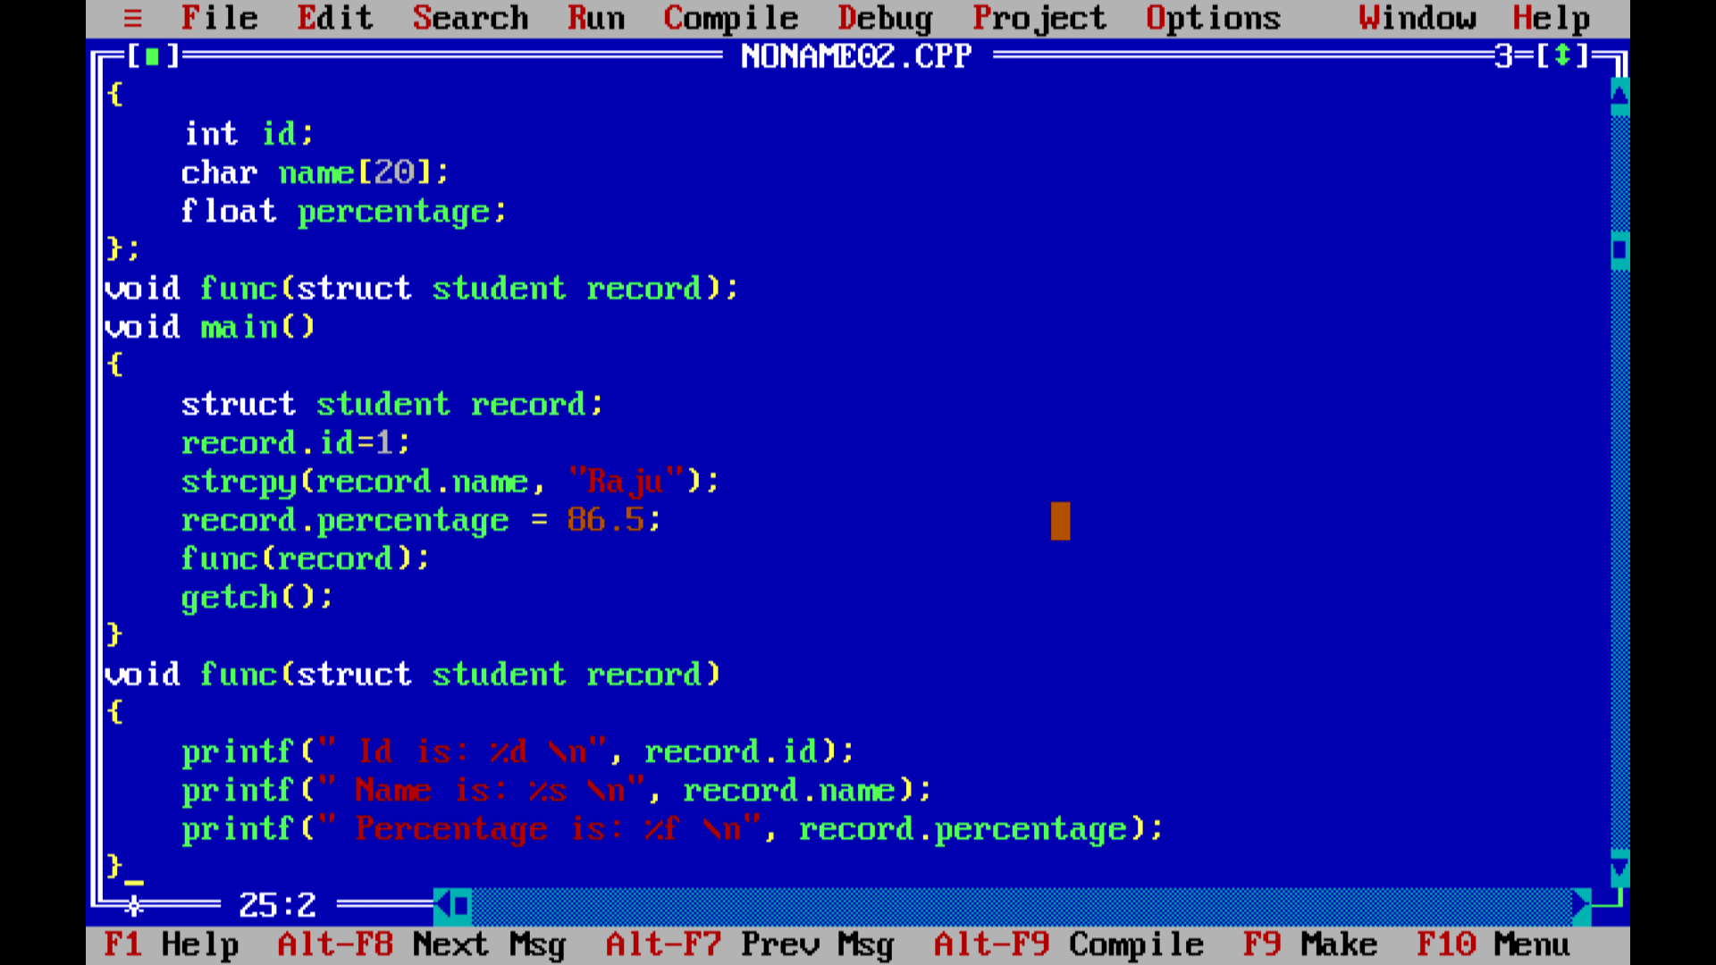

Slide 11
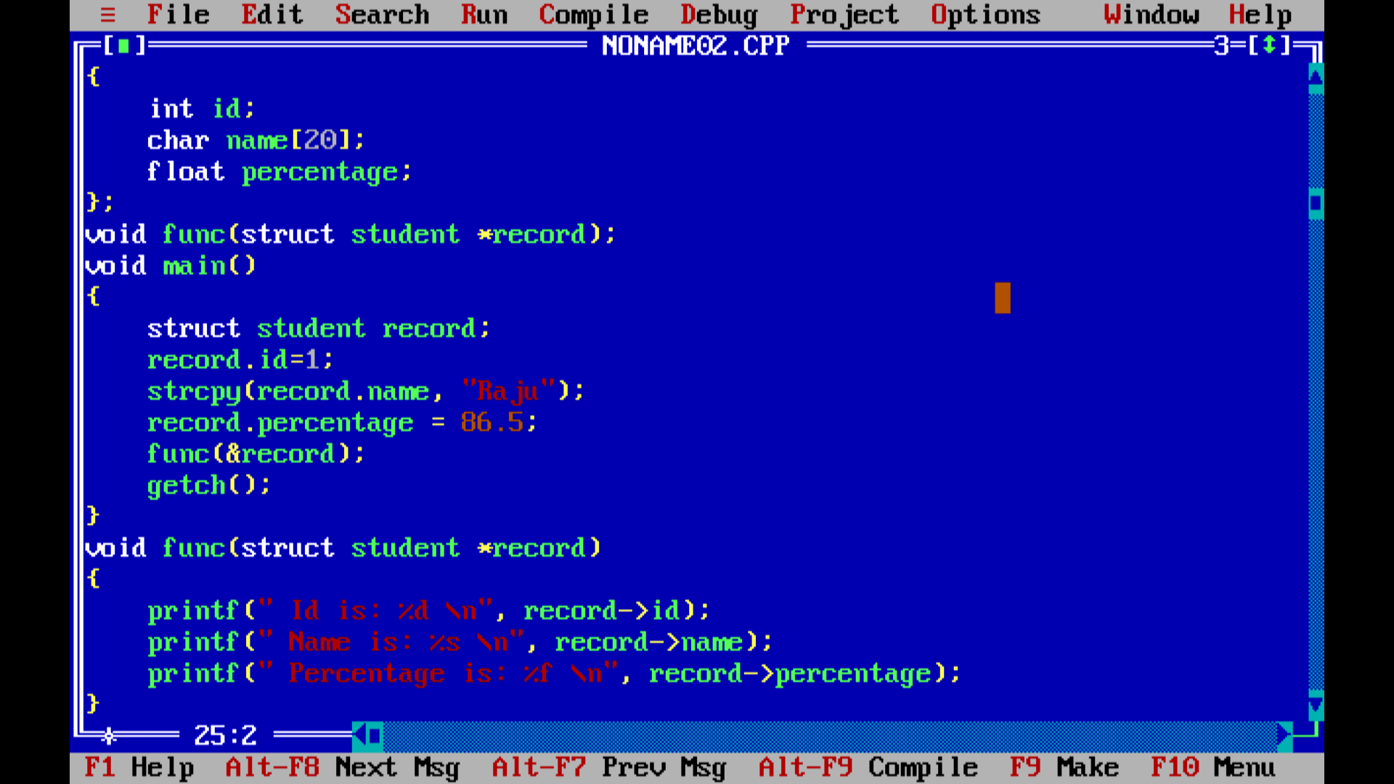

Slide 12
UNION
union <union tag>
{
datatype member1;
datatype member2;
};
Example:
union book
{
int pages;
char bookname[20];
float price;
};
Union is the user-defined data type. It is the collection of different datatype grouped together under a single variable name for convienient handling.
The members of the union share a single storage space.
Amount of space allocated for storage is the amount needed for the largest member of the union.
Both are user-defined data types.
Both can contain heterogeneous data.
The elements of both structure and union can be accessed through dot(.) operator.
It is possible to have union within union and structure within structure.
Union<union tag> variable name;
Example—
union account a1;
union account a1,a2,a3;

Slide 13
SIMILARITIES BETWEEN STRUCTURE AND UNION
Both are user-defined data types.
Both can contain heterogeneous data.
The elements of both structure and union can be accessed through dot(.) operator.
It is possible to have union within union and structure within structure.

Slide 14
STRUCTURE | UNION
1)The keyword struct is used to declare the structure. 2)All the data members of the structure are active at a time. 3)We can access all the members of the structure at anytime. 4)Memory is allocated for all the variables. 5)All the members of the structure can be initialised. | 1)The keyword union is used to declare the union. 2)Only one data is active at a time. 3)Only one member of the union can be accessed at a time. 4)Memory is allocated for only one variable. 5)Only the first member of the union can be initialised.

Slide 15
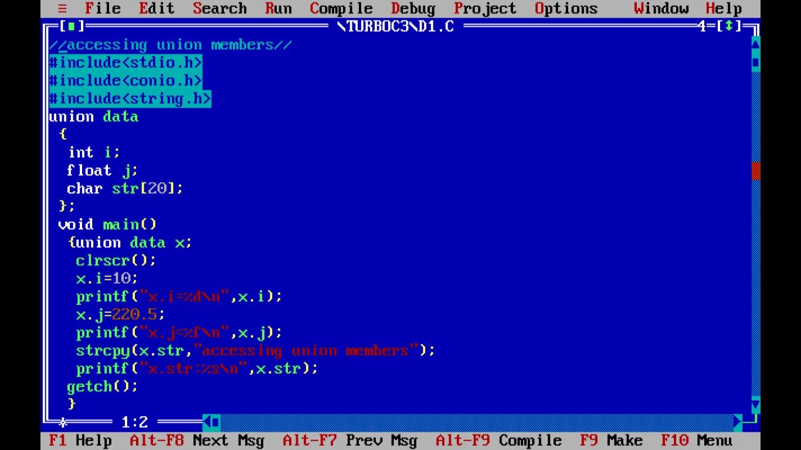

Slide 16
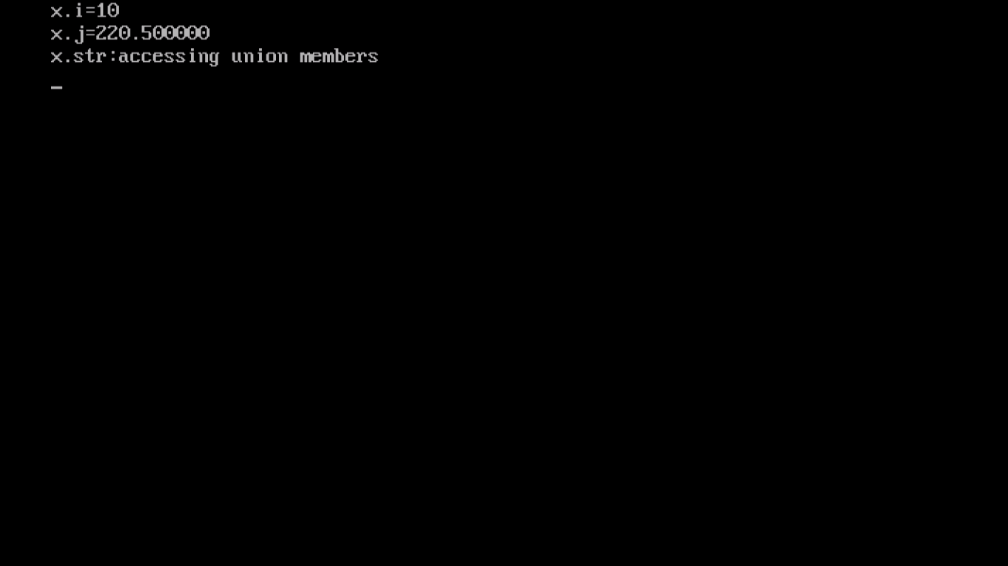

Slide 17
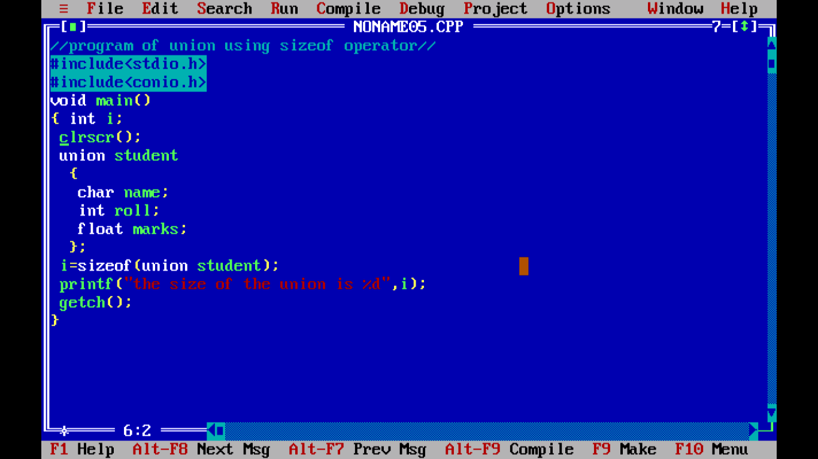

Slide 18
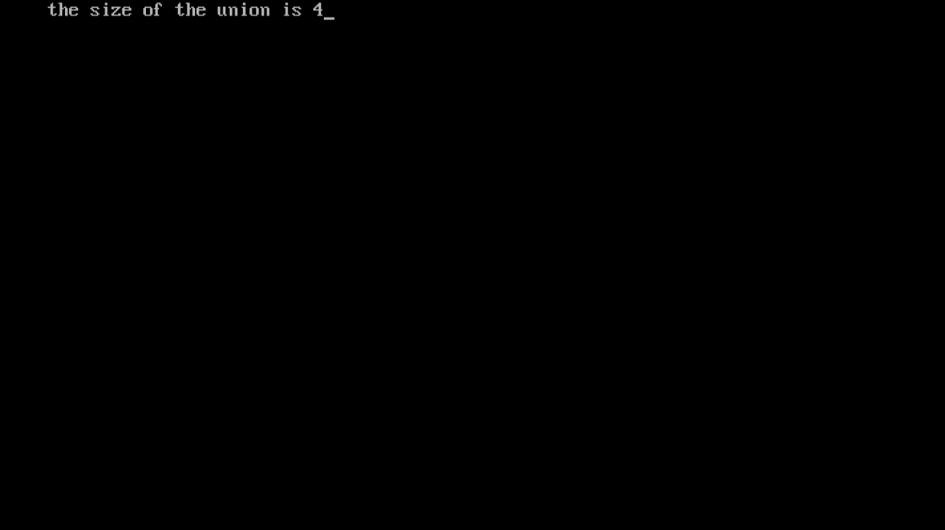

Slide 19
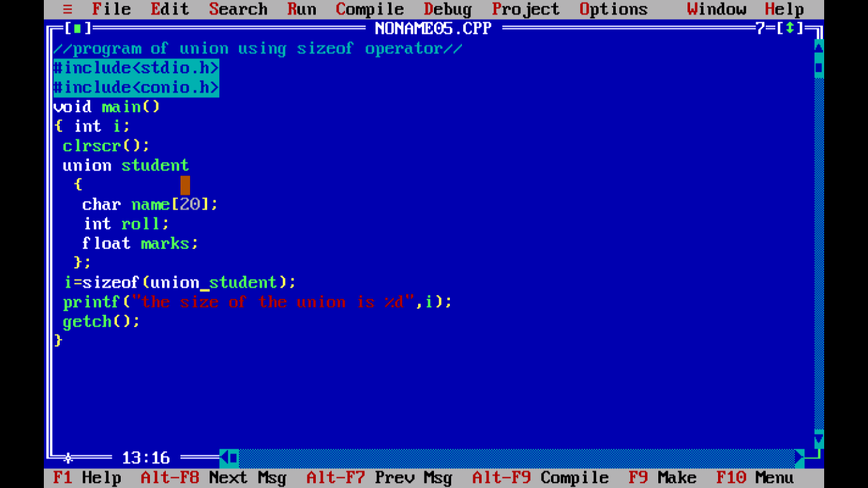

Slide 20


Slide 21
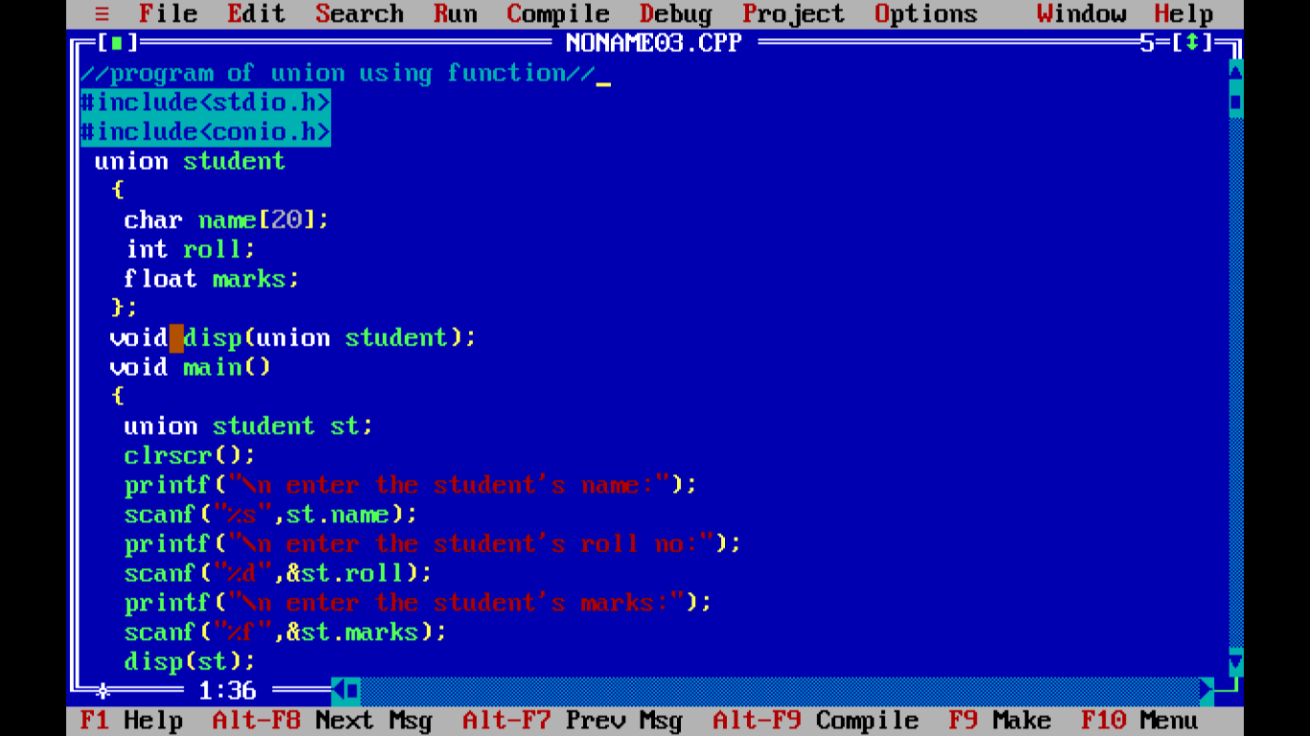

Slide 22
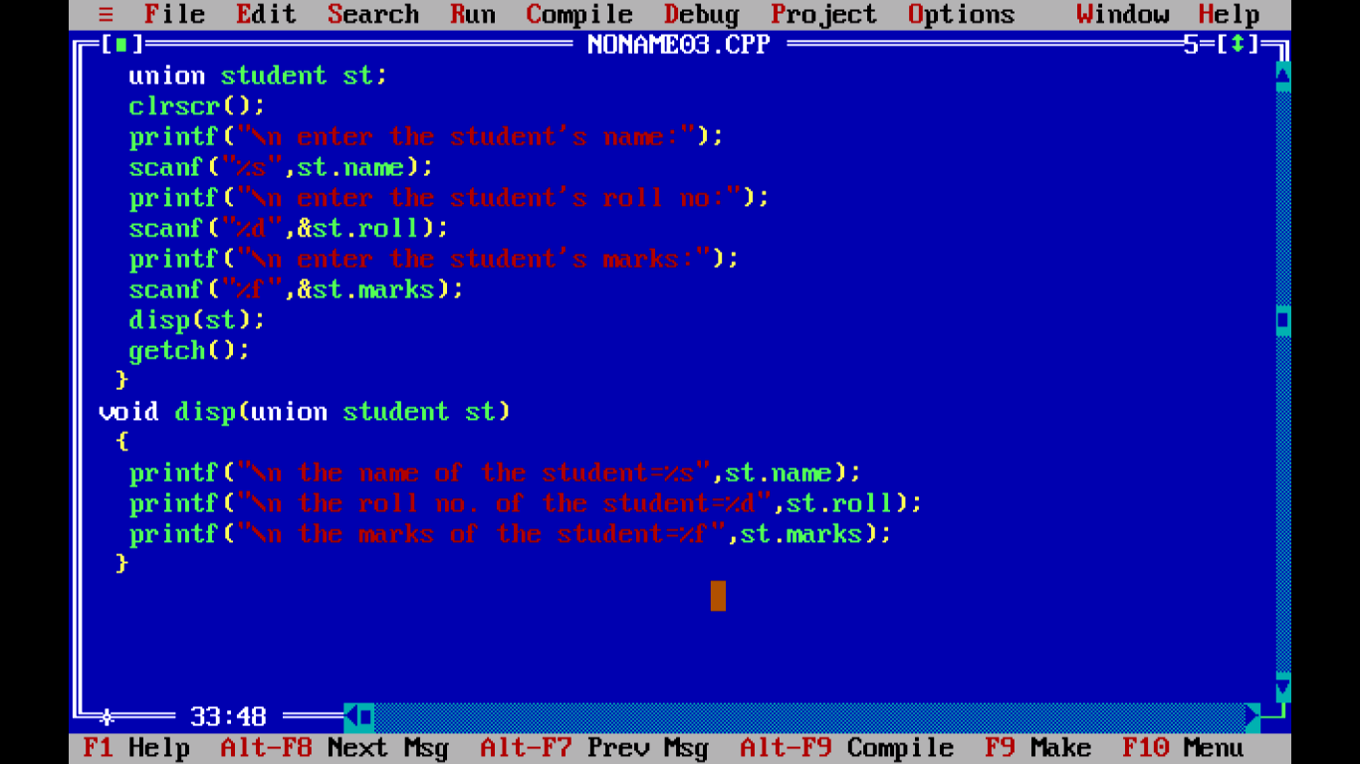

Slide 23
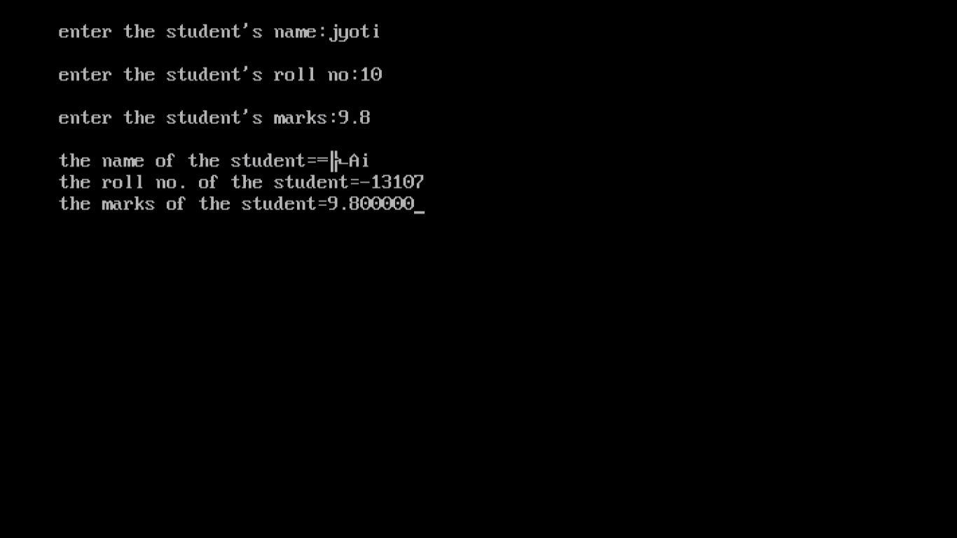

Slide 24
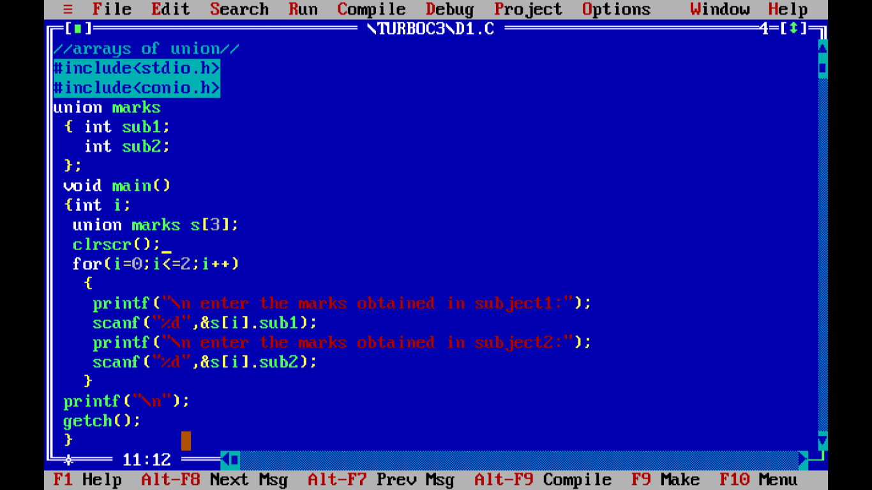

Slide 25
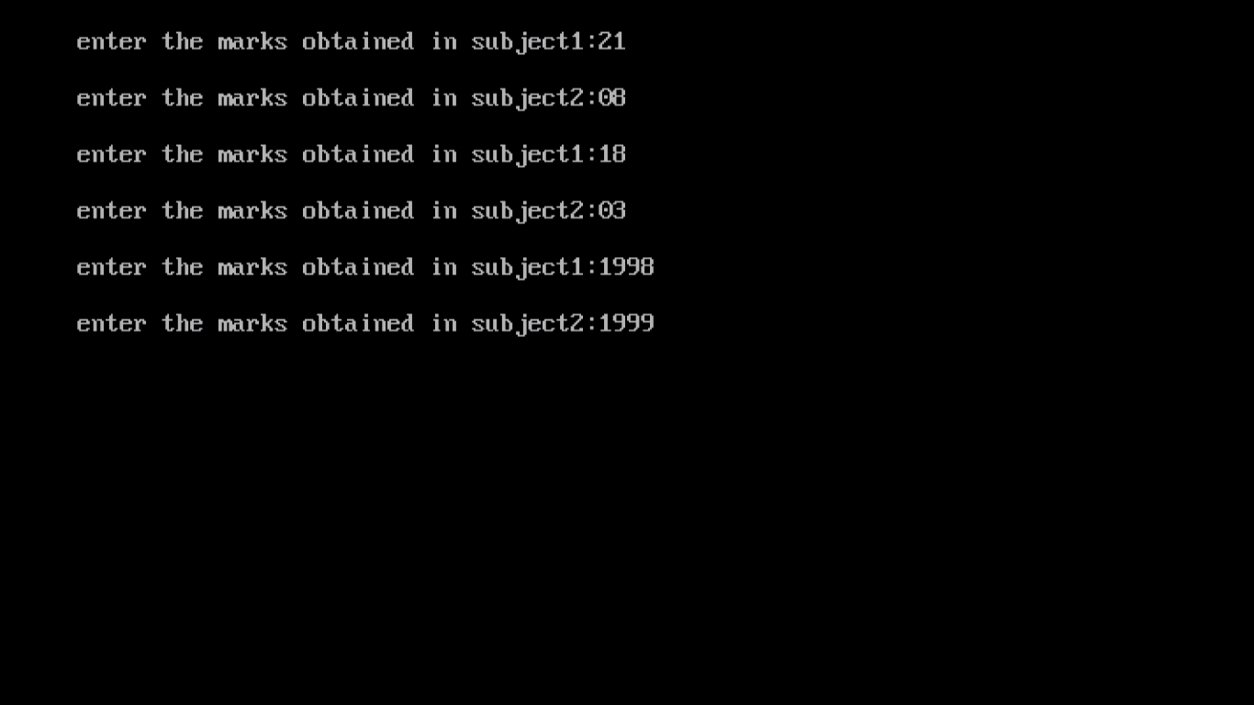

Slide 26
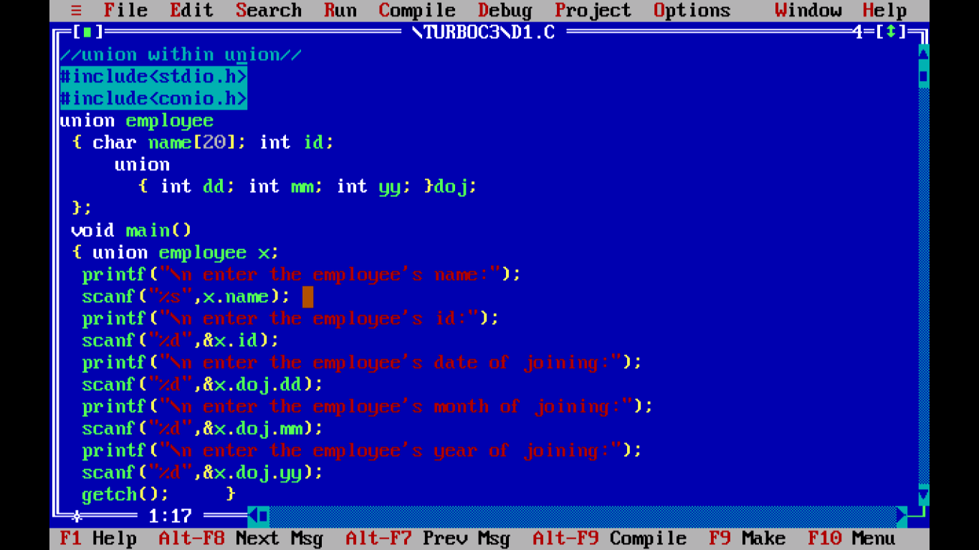

Slide 27
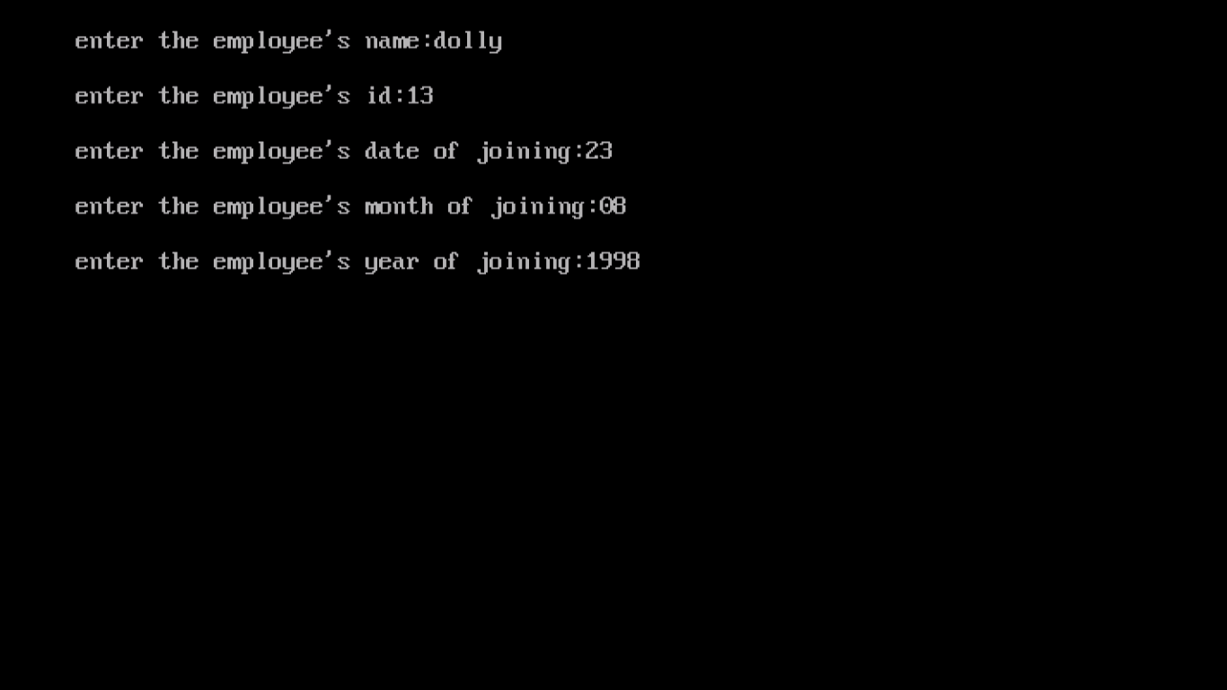

Slide 28
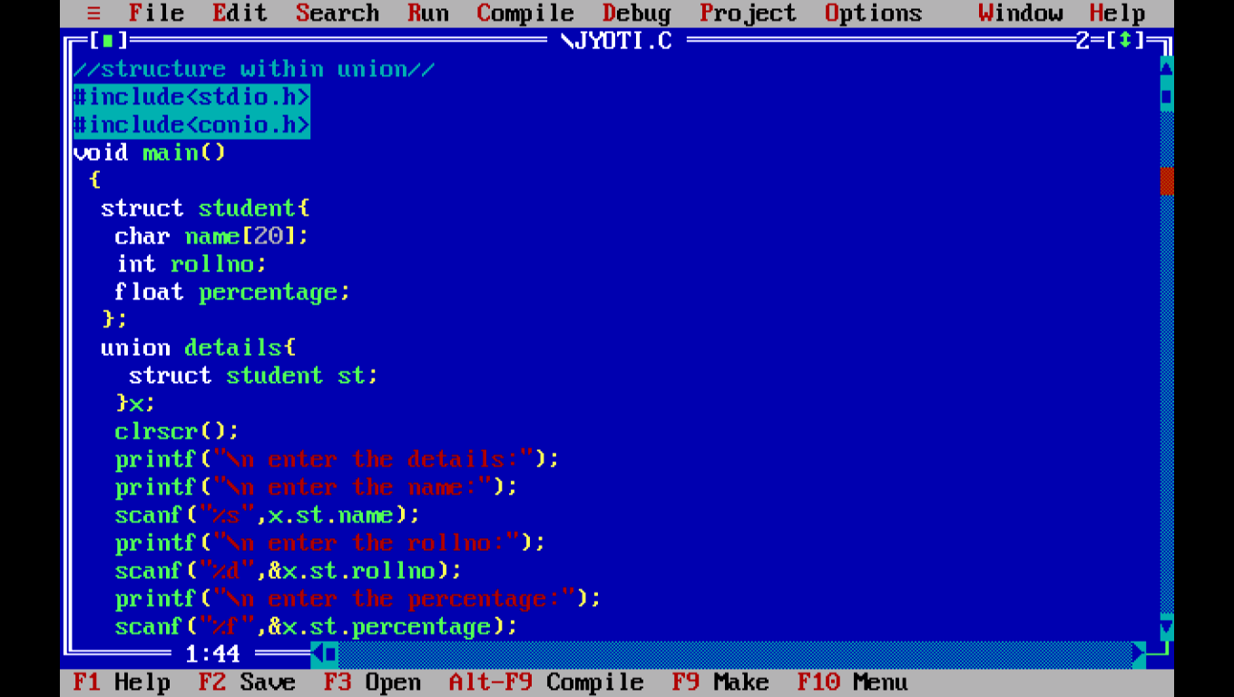

Slide 29
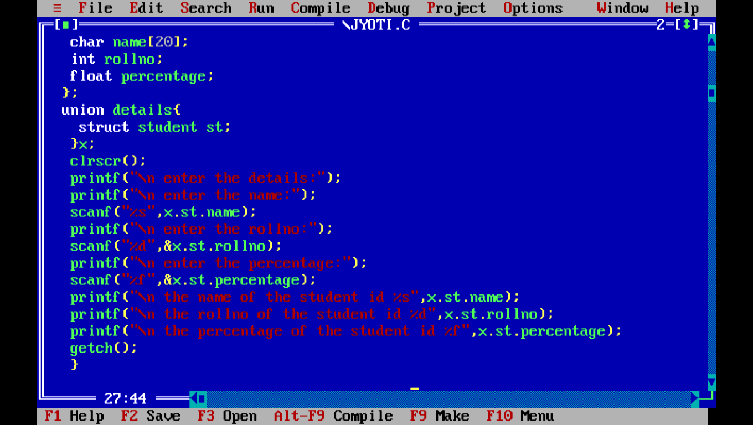

Slide 30
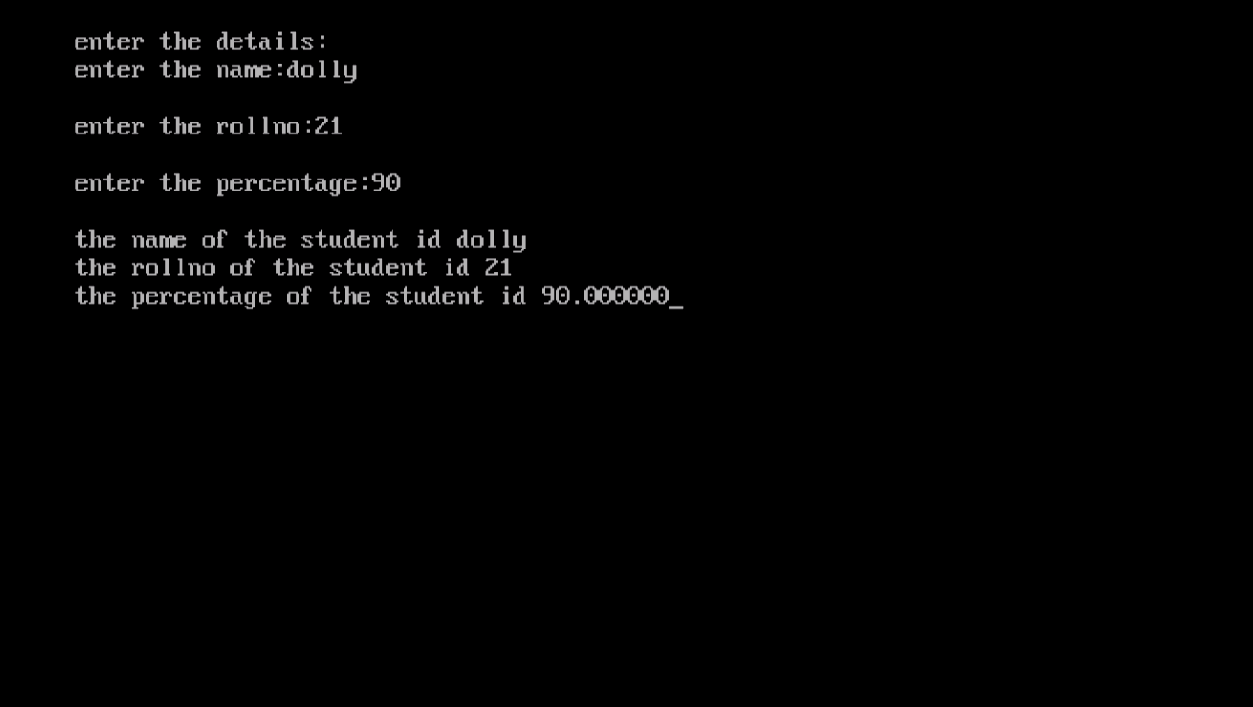

Slide 31
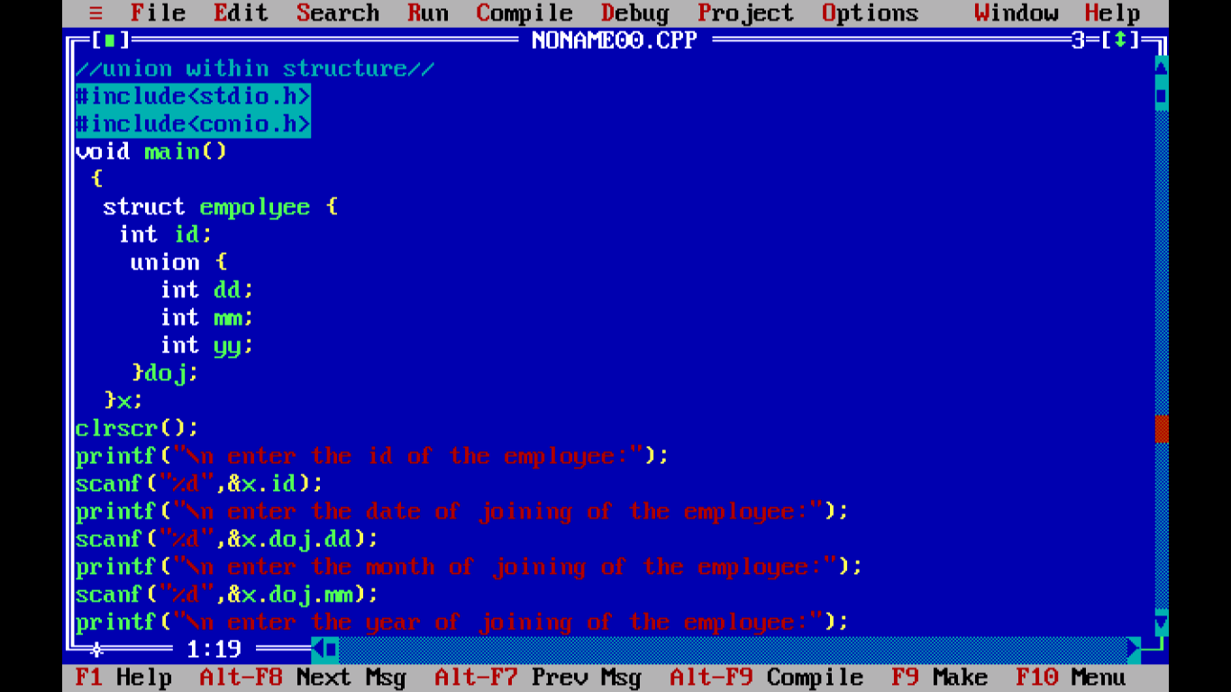

Slide 32
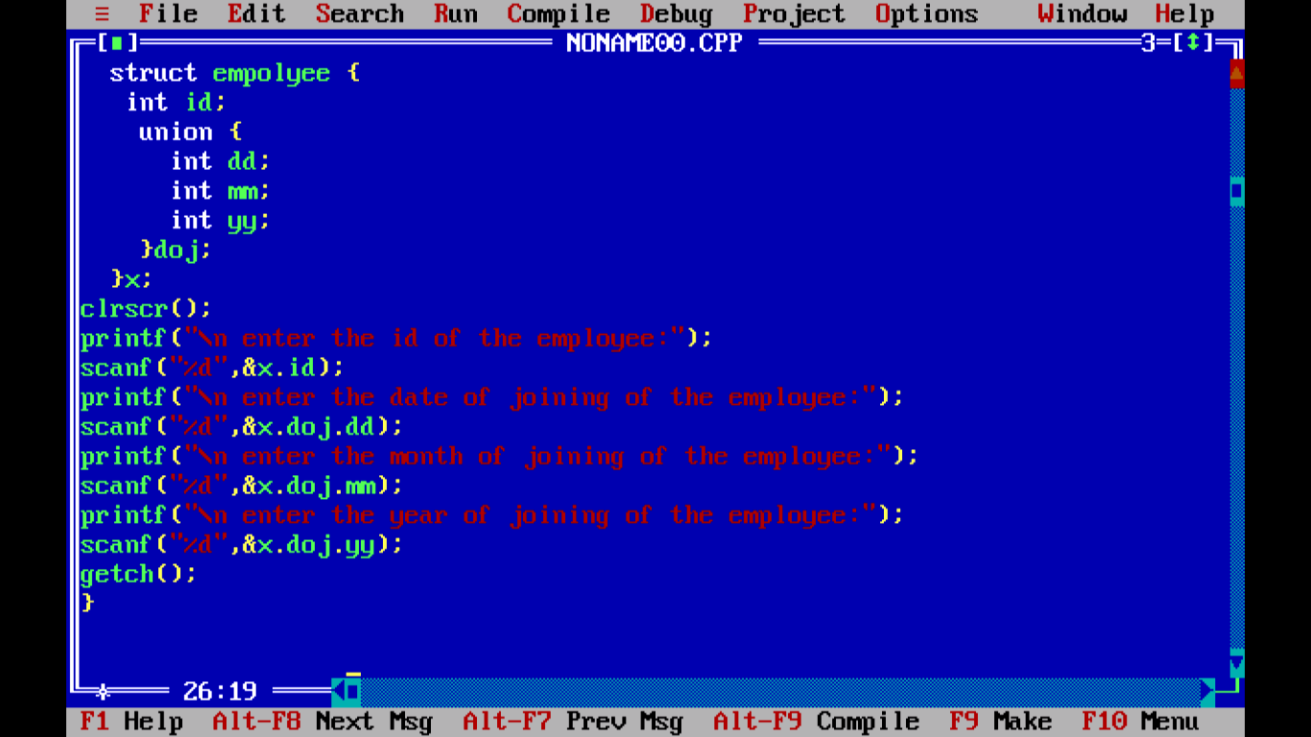

Slide 33
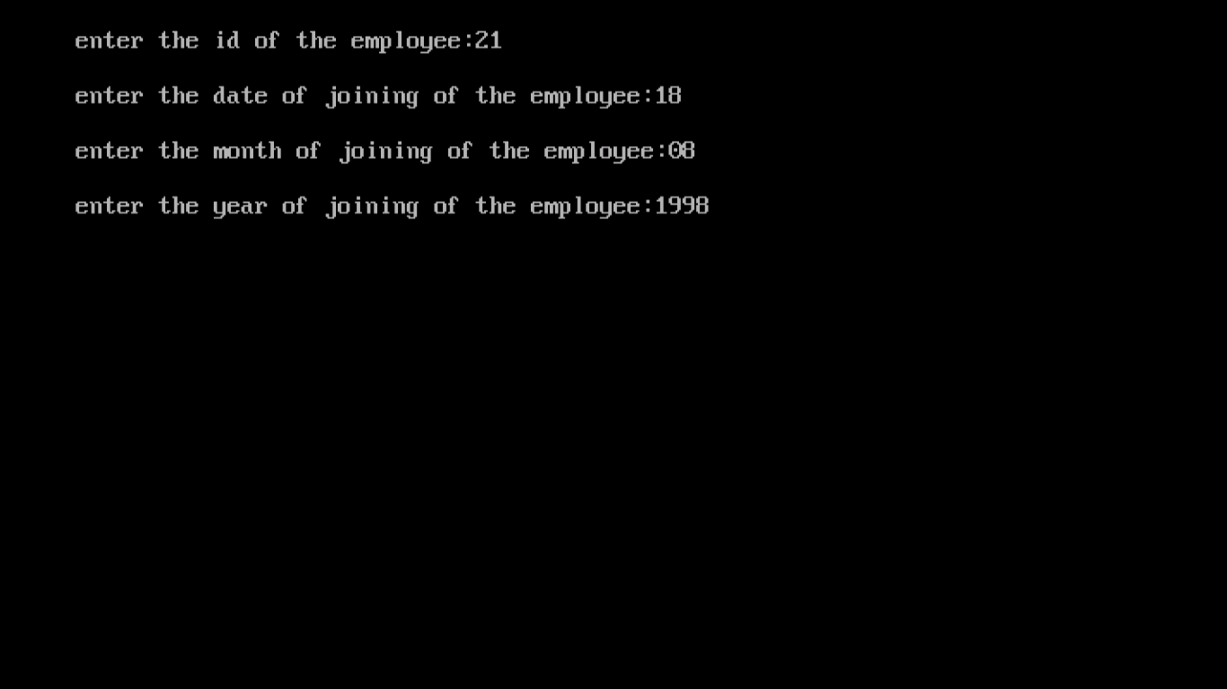

Slide 34
THANK YOU

